Slide 1
Prometic Dashboards
Review of dashboards

Slide 2
Comparison Report
Written and distributed 10th February 2016
Defined requirements of business
Create a shortlist of products and compare them to requirements

Slide 3
Technical Requirements
Technical
Users
Other
Connect to SQL
Connect to Salesforce
Import and export to excel
Web Based
ETL
Interactive Reports
Equal service globally
Easy to train and use
Should be able to brand reports
Capture budget information
Financial forecasting
“Agnostic” – read any data
Screen Sharing
Wide marketplace
Should be well rated
Notes:
SQL - Syspro is based on SQL – any solution should connect to this system
Salesforce - Forecasts are held in Salesforce – a solution should connect to this system
Excel - Maps are easily maintained in excel and exporting to excel allow users to do further analysis
Web – Access to dashboards should be available every where
ETL – part of the process for taking data from Syspro and other systems into a reportable format
Interactive Reports – dashboards should allow drilldown/filter functionality
Equal Service – performance should be the same wherever in the world
Easy to use – training should take less than 30 minutes

Slide 4
The Shortlist
Shortlist
Notable Mentions
Qlik
Tableau
Spotfire
SiSense
Ezora
Microsoft
Syspro Dashboards
Notes:
Qlik – previous experience with developing environment
Tableau – highly rated product
Spotfire – good market penetration in Pharma
SiSense - New product that promises a lot of functionality
Ezora – Bruce asked us to look into this, this tool is from a small company based in Ireland that provide dashboards to pharmacy and coffee shops franchisees
Microsoft – The amount of work and money involved would be
Syspro Dashboards – do not offer the functionality to meet basic requirements – can only report on a company basis

Slide 5
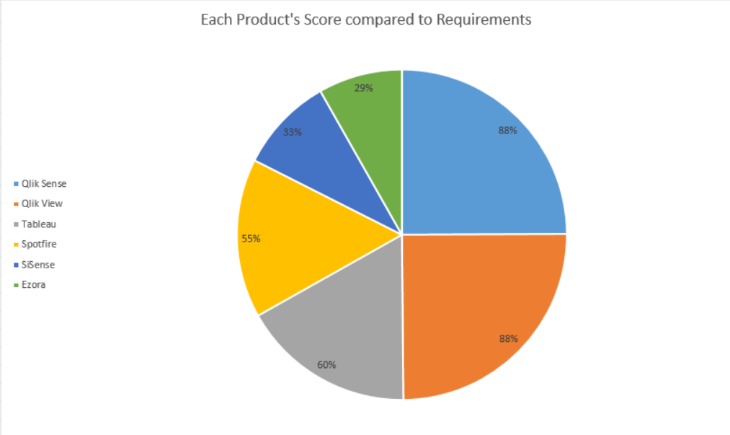
Review of Scores

Slide 6
Finalists
Qlik Sense
Qlik View
Tableau
New product
Web based
Intuitive to use
Excellent ETL function
Natively supports mobile
Established product
Web based
Intuitive to use
Excellent ETL function
Established product
Web based
Intuitive to use
Notes:
Both Qlik products (View and Sense) gained equivalent scores, Qlik Sense was picked as the better product as new features are being developed

Slide 7
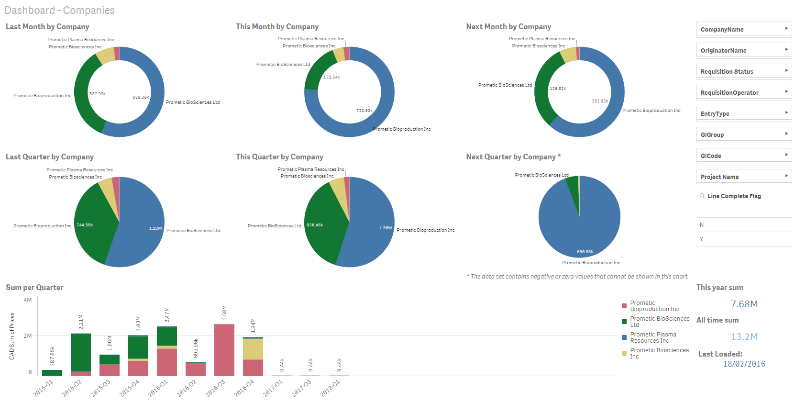
Qlik sense Example

Slide 8
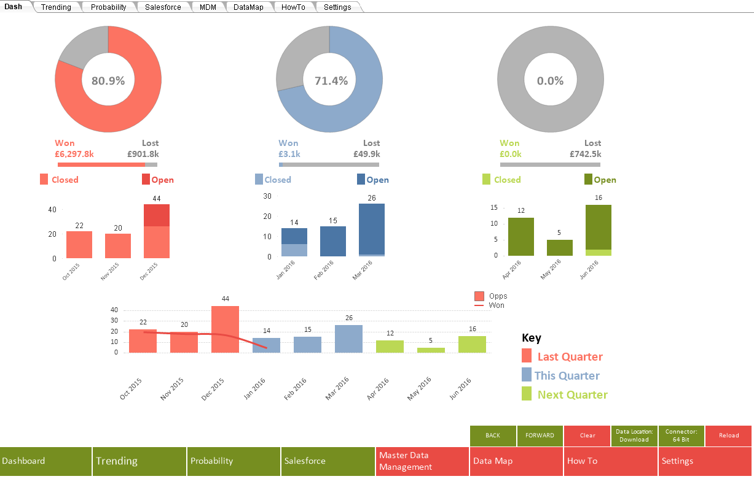
Qlik View Example

Slide 9
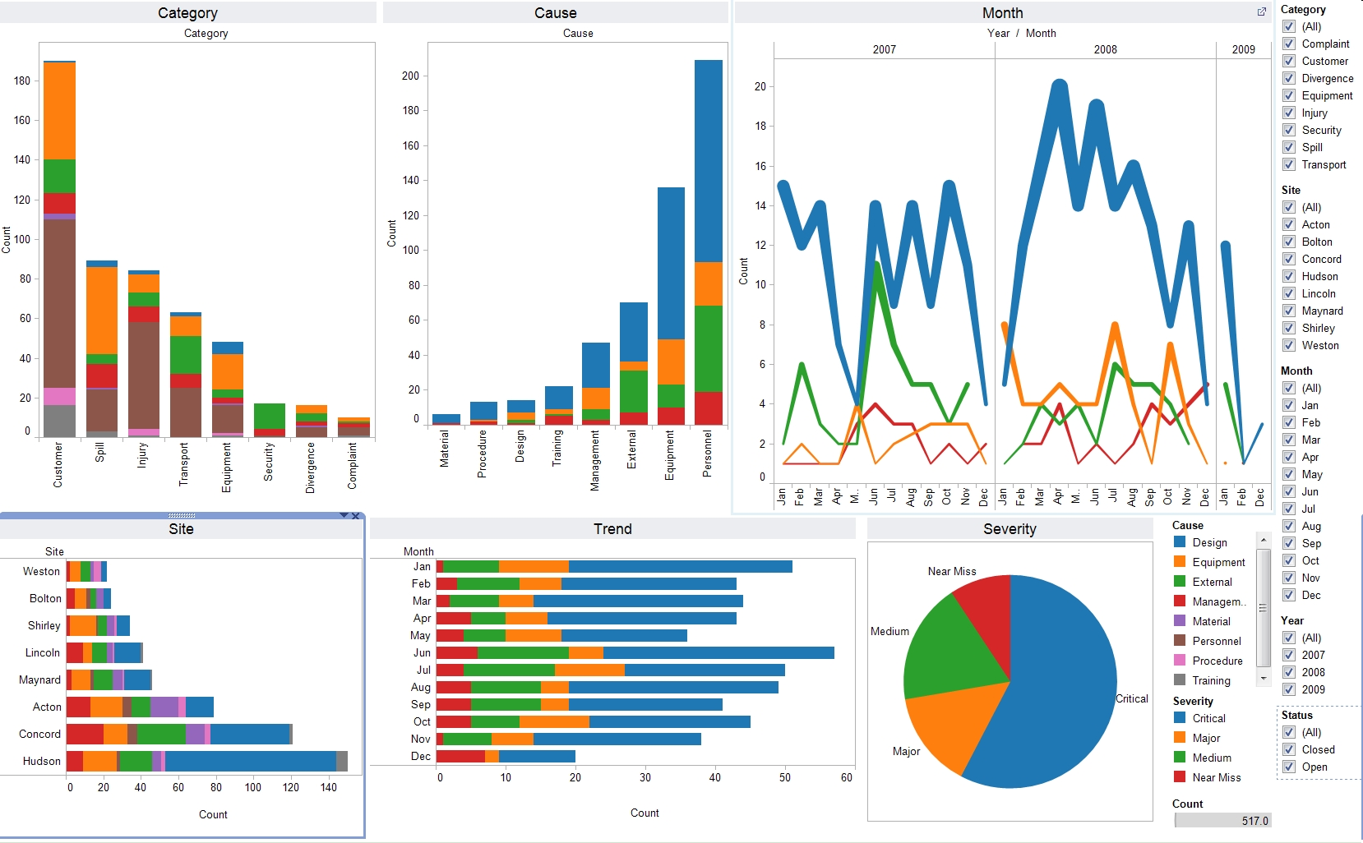
Tableau Example
*note, source of example https://apandre.wordpress.com/category/tableau/ as we were unable to extract data in a meaningful fashion without an ETL tool

Slide 10
Next Steps
Financial Reports
Dashboards
Others
Copy code from dashboards into crystal
Define new process for monthly reports
Engage with teams to arrange testing
Recreate reports in crystal
Balance sheet – awaiting testing 2nd March
Financial Statement
Trial Balance
Budget vs Actual
Define requirements
Conduct interviews with execs to capture requirements of how the dashboards should look
Generate list of products to be tested (focusing on free/open source) based off interviews and requirements
Review products, shortlist and provide demonstrations to execs
Review alternatives to integrate Salesforce & Syspro
Review alternatives for forecasting data
Review alternatives to integrate Act-On, Google Analytics, Salesforce for board reporting

Slide 11
Qlik ETL and reports

Slide 12
Non Qlik ETL and reports

